Slide 1
Decision Tree Algorithms
Brian Nguyen
COMP 379 – Fall 2021

Slide 2
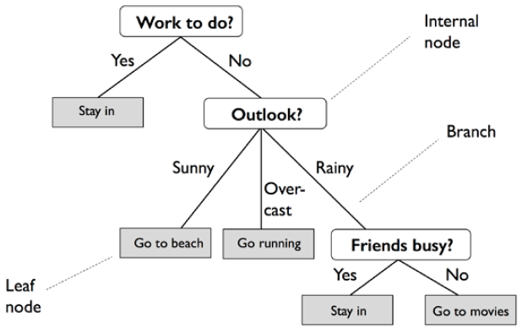
decision tree (noun):
a tree diagram… for making decisions in business or computer programming… in which branches represent choices with associated risks, costs, results, or probabilities
(Merriam Webster)
Notes:
Sources:
https://www.merriam-webster.com/dictionary/decision%20tree
https://medium.com/@jorgesleonel/decision-trees-99b02f2390a0

Slide 3
Why Decision Trees?
Can be used for both classification and regression problems as a supervised machine learning algorithm
Classification: Outcomes are discrete/categorical
Regression: Outcomes are continuous
Supervised: Having pre-defined target variables
Often mimics human-level thinking processes – making it simple to understand and interpret the data
Underlying logic supporting decisions are more apparent
Notes:
Sources:
https://medium.com/deep-math-machine-learning-ai/chapter-4-decision-trees-algorithms-b93975f7a1f1
https://medium.com/@jorgesleonel/decision-trees-99b02f2390a0

Slide 4
Why NOT Decision Trees?
Outputs must be categorical in nature
Instability – Slight variations in training data can alter attribute determination (i.e., different DT variations)
Overfitting – DT creating too specific of criteria amongst subsets, creating prediction inaccuracies
Notes:
Sources:
https://medium.com/deep-math-machine-learning-ai/chapter-4-decision-trees-algorithms-b93975f7a1f1
https://medium.com/@jorgesleonel/decision-trees-99b02f2390a0

Slide 5
Common DT Algorithms
Iterative Dichotomiser 3 (ID3) | C4.5 | Classification and Regression Tree (CART)
Utilizes Entropy and Information Gain (IG) metrics to recursively determine which attributes are used as classifiers for each data subset | Direct improvement upon ID3 algorithm Utilizes IG and Gain Ratio (IGR) metrics to handle both continuous and missing attribute values | Utilizes Gini Impurity metric to produce both classification and regression DTs, based on the dependent variable
Notes:
Sources:
https://medium.com/@jorgesleonel/decision-trees-99b02f2390a0

Slide 6
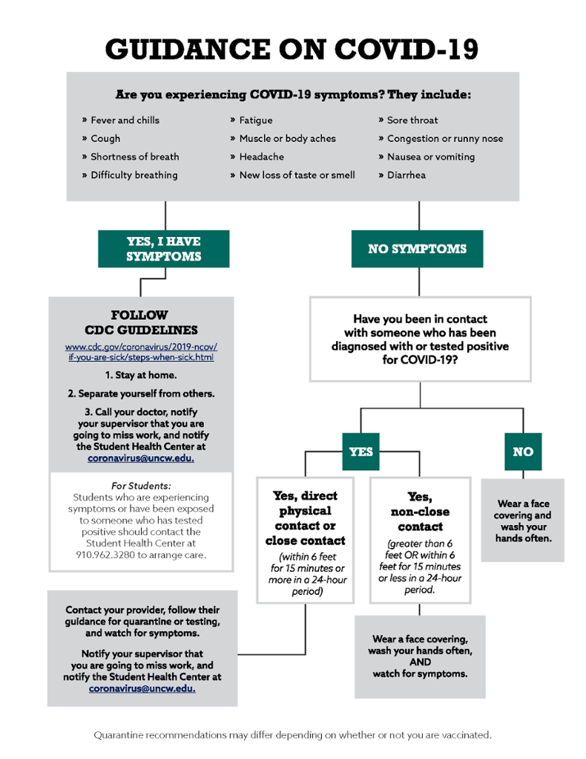
Business
Healthcare
Industry.
Applications.
Notes:
Sources:
https://venngage-wordpress.s3.amazonaws.com/uploads/2021/07/Product-Business-Decision-Tree-Template.png
https://uncw.edu/hr/coronavirus/returntocampus/images/covid-19-decision-tree.png

Slide 7
Resources
https://www.merriam-webster.com/dictionary/decision%20tree
https://medium.com/@jorgesleonel/decision-trees-99b02f2390a0
https://medium.com/deep-math-machine-learning-ai/chapter-4-decision-trees-algorithms-b93975f7a1f1
https://venngage-wordpress.s3.amazonaws.com/uploads/2021/07/Product-Business-Decision-Tree-Template.png
https://uncw.edu/hr/coronavirus/returntocampus/images/covid-19-decision-tree.png
https://slidesgo.com/theme/pical-platform-business-plan#search-tree&position-10&results-52

Slide 8
Thank you!

